Slide 1
(a)
(a)
(b)
(b)

Slide 2
(c)
(d)

Slide 3
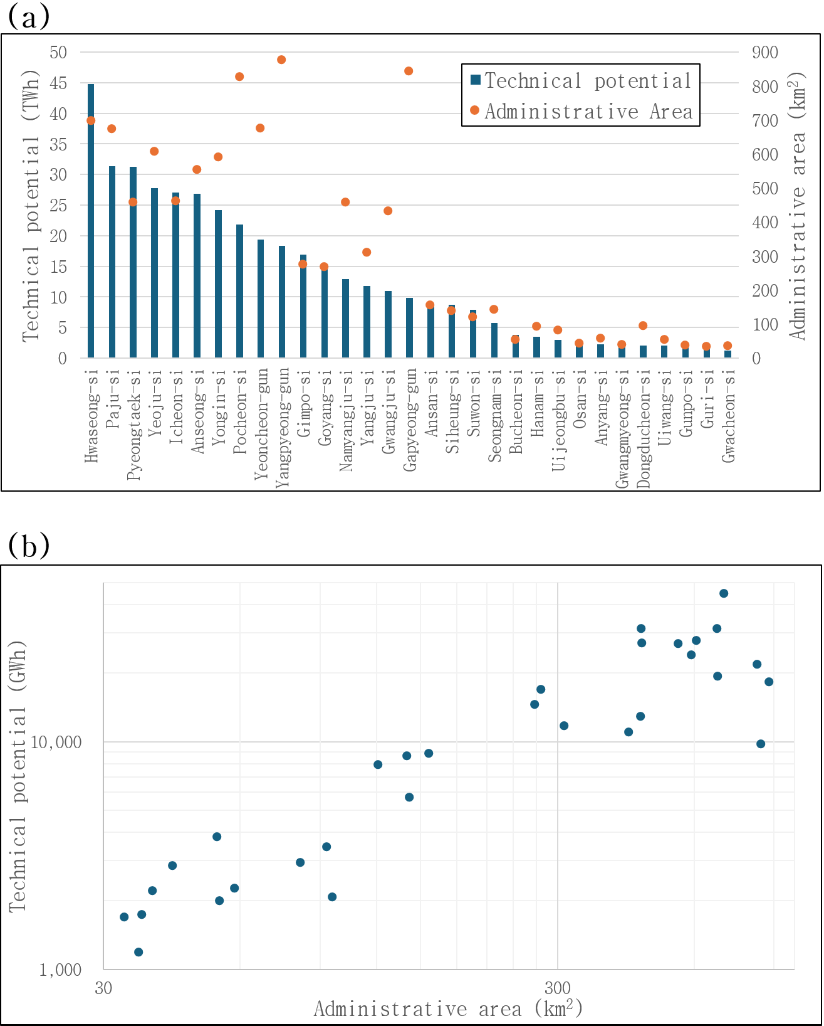
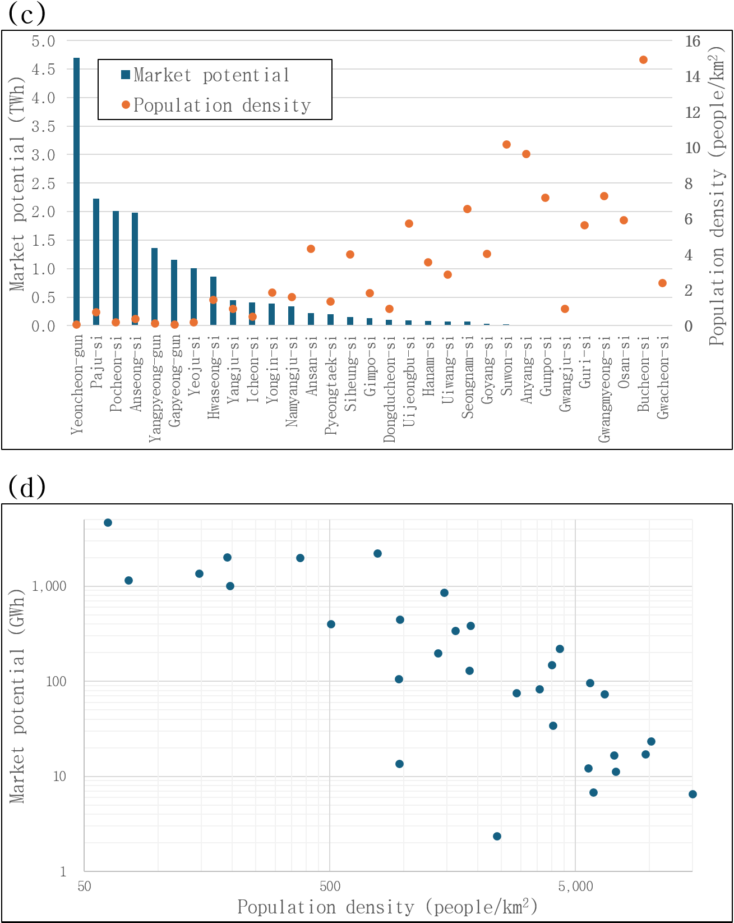
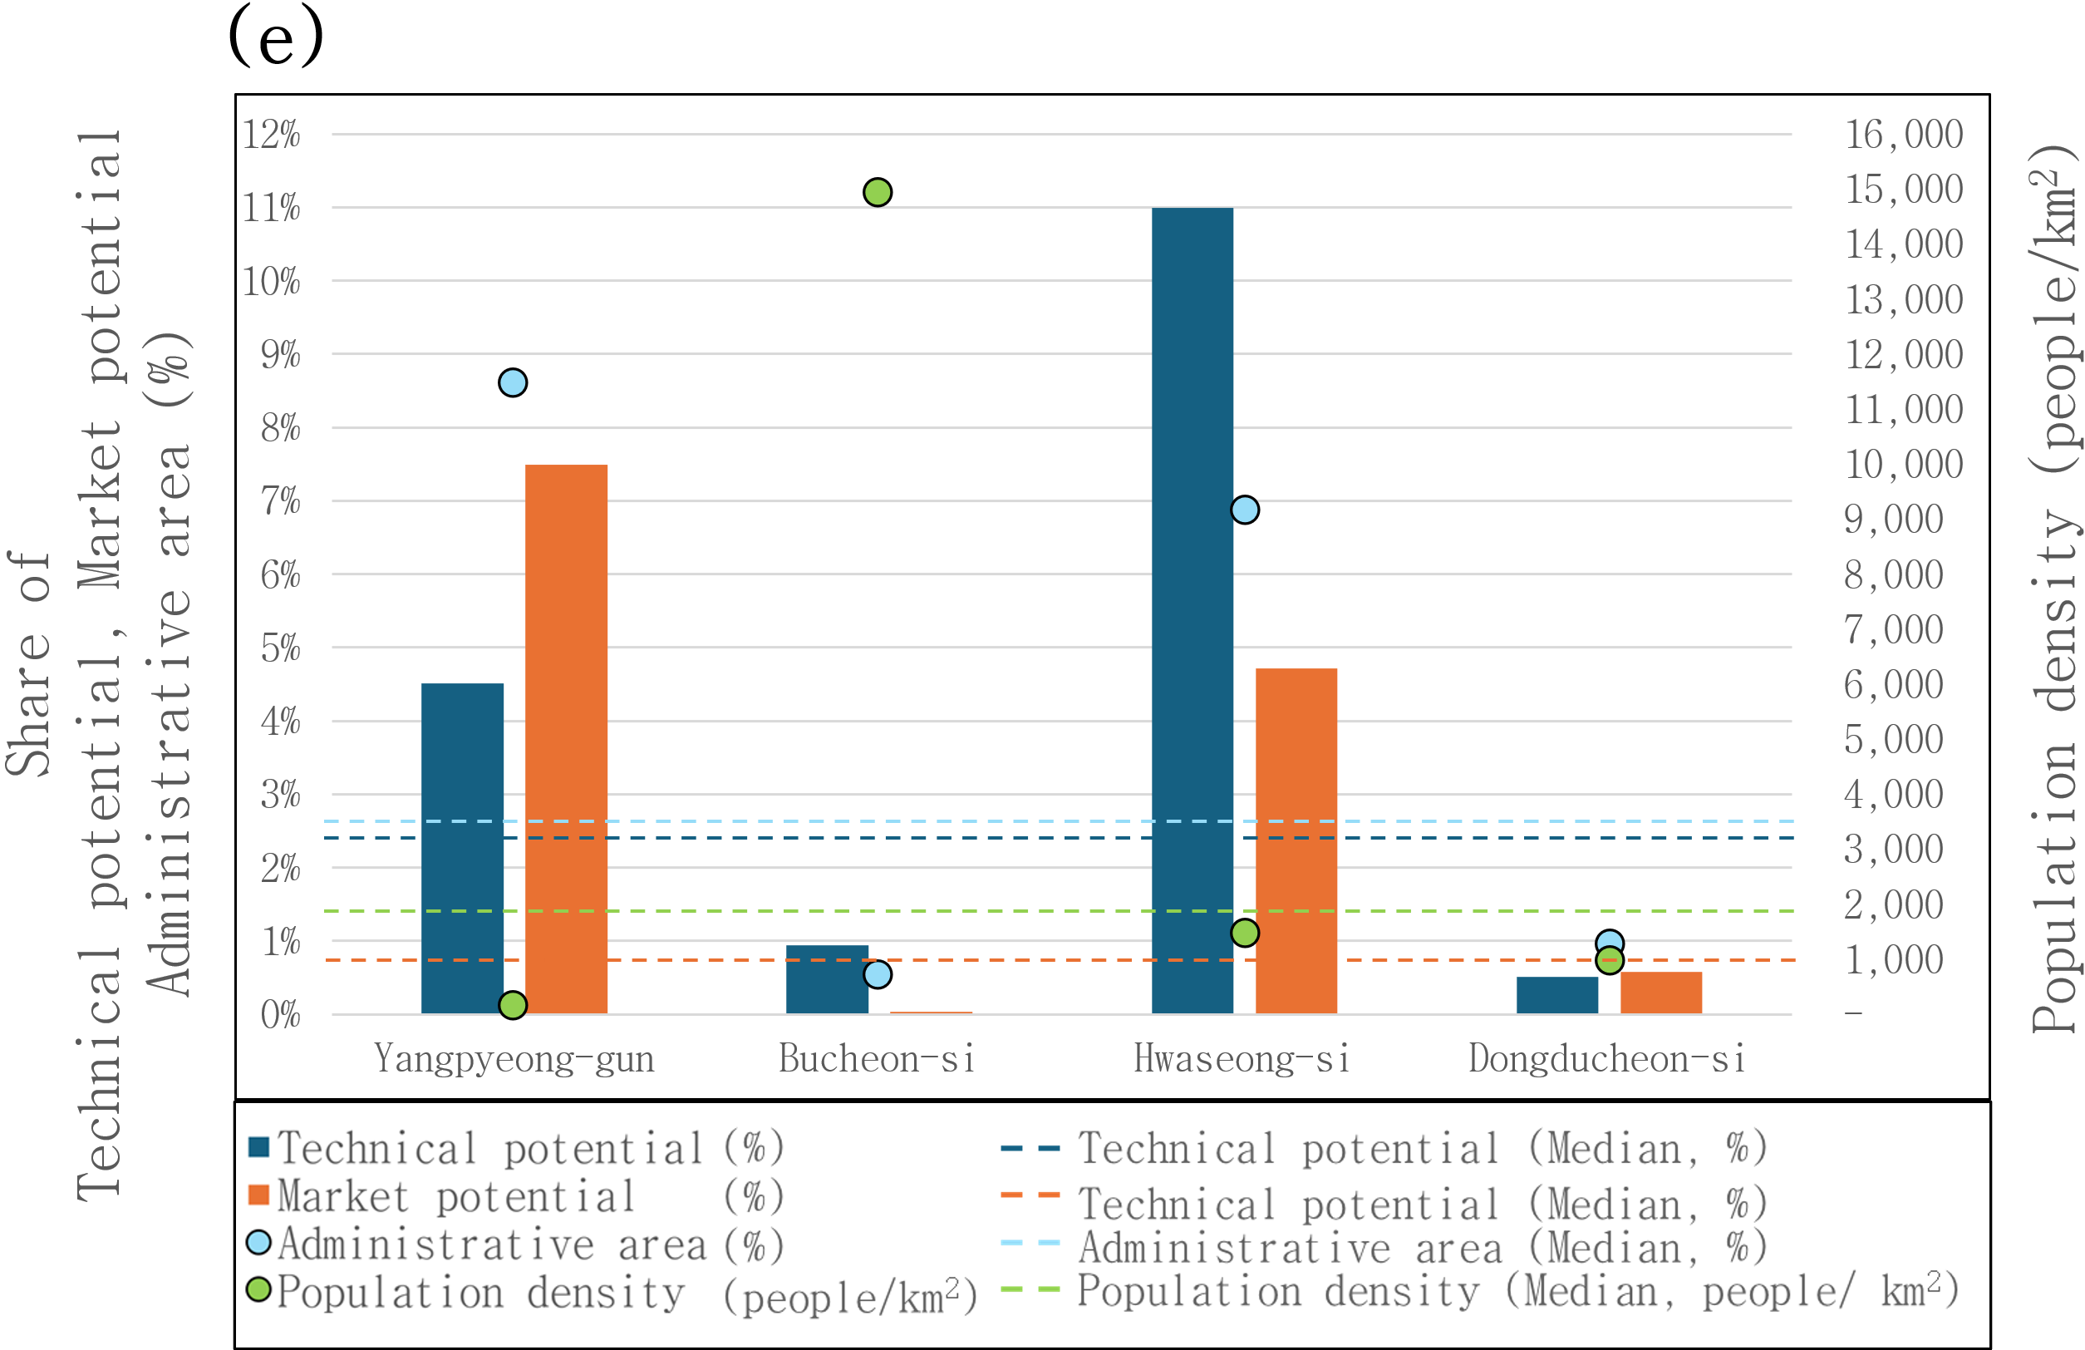
(a) Ranked distribution of technical potential and administrative area
(c) Ranked distribution of market potential and population density
(c) Relation between technical potential and administrative area
(d) Relation between market potential and population density
(e) Comparison of selected municipalities

Slide 4
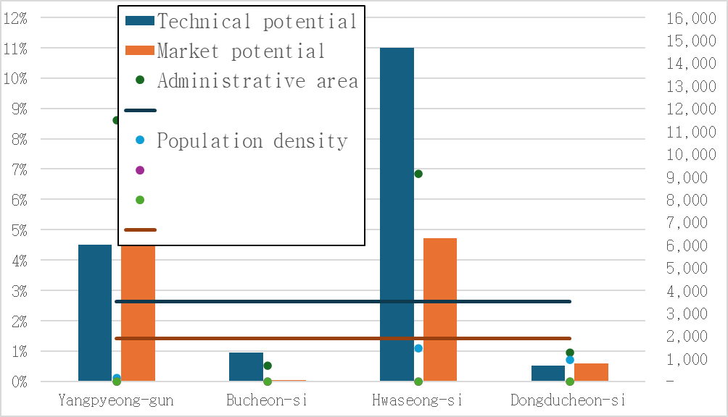

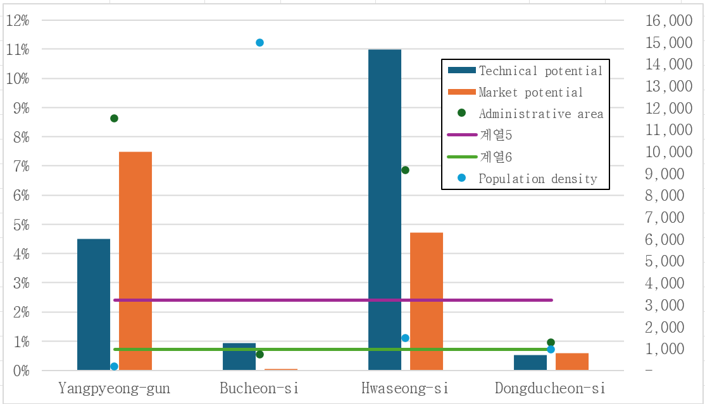
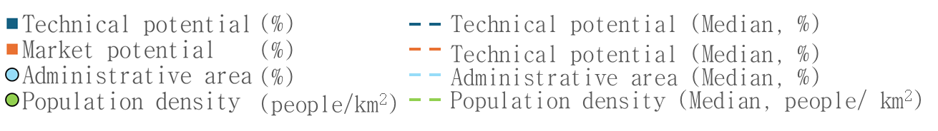
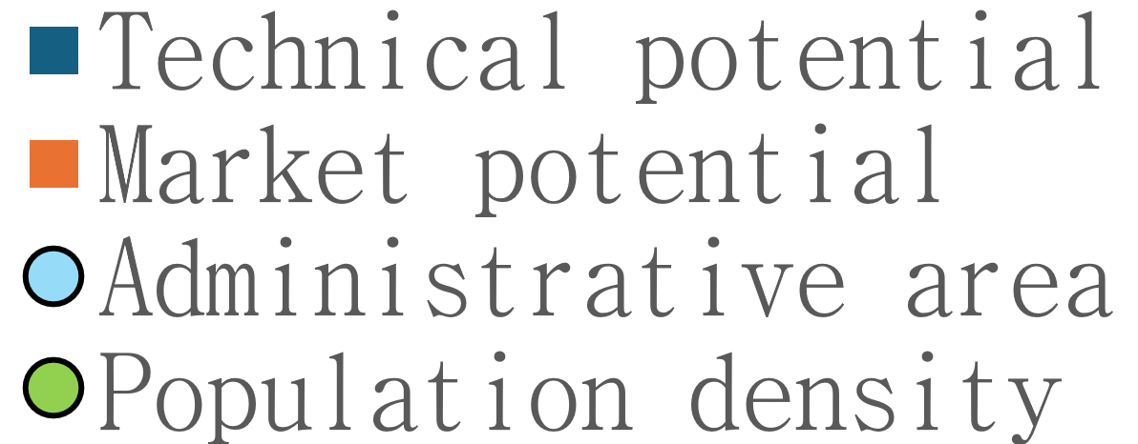
(e)
Population density (people/km²)
Share of
Technical potential, Market potential
Administrative area (%)
(%)
Technical potential (Median, %)
(%)
Technical potential (Median, %)
(%)
Administrative area (Median, %)
(people/km²)
Population density (Median, people/ km²)

Slide 5
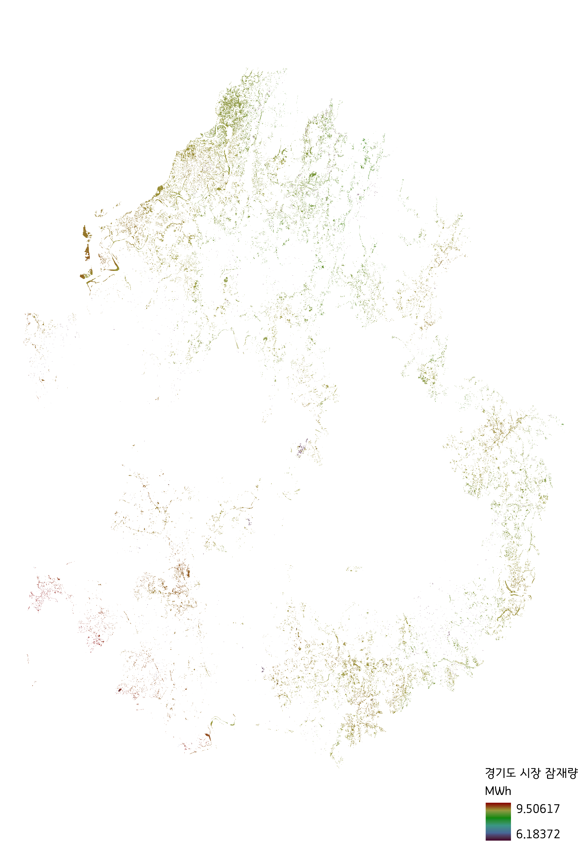
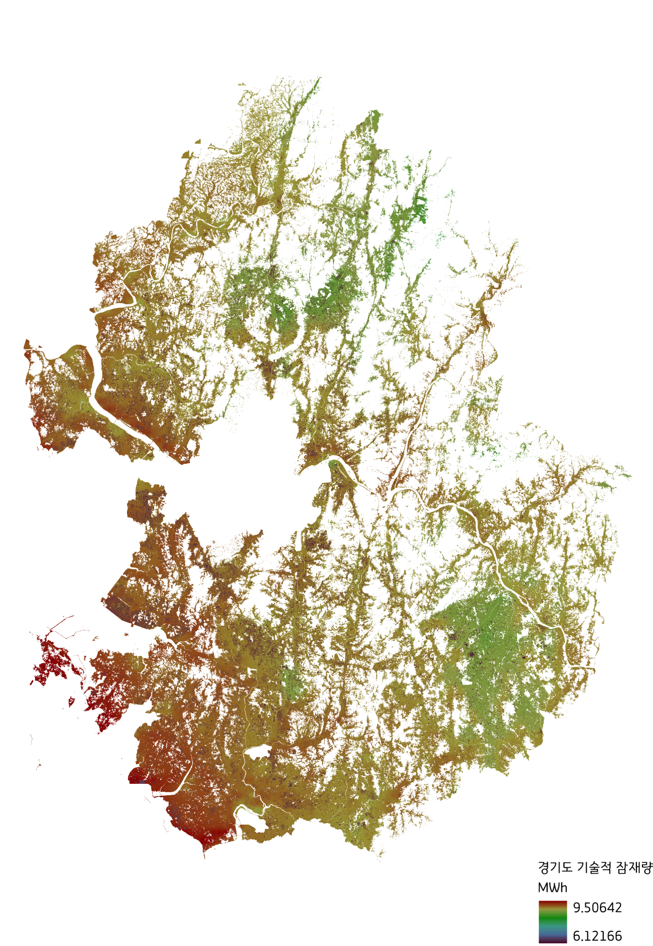
Technical potential
Market potential

